Slide 1
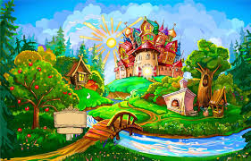
Englishland

Slide 25
